Slide 1
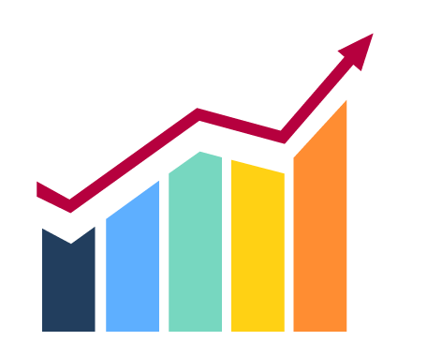
POWERPULSE-ENERGY CONSUMPTION DASHBOARD
BATCH - 04
B.SAI NIVEDITHA - 2111CS030103 Y.SANTOSH SAMPATH - 2111CS030111 SHARVANI BANALA - 2111CS030115 M.VAISHNAVI - 2111CS030148

Slide 2
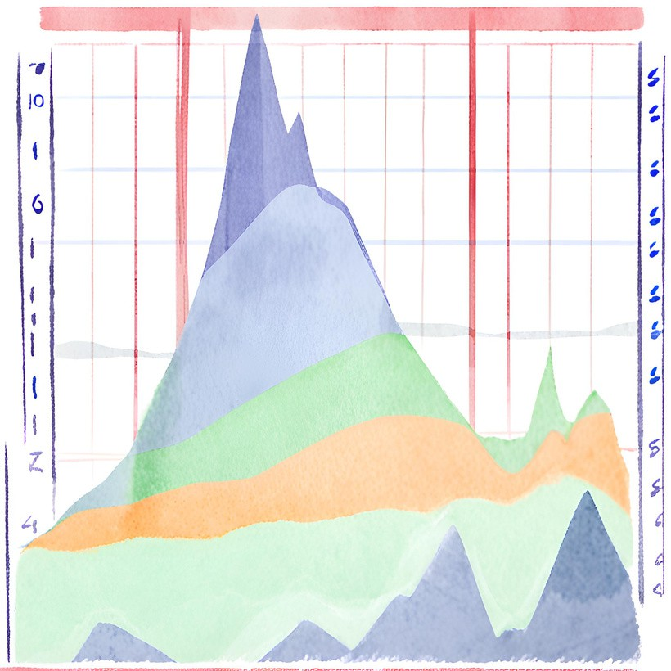
Introduction
In today's era of sustainability and economic efficiency, developing energy consumption dashboards using tools like power bi is crucial for organizations aiming to optimize energy use. These interactive platforms provide a comprehensive overview of energy consumption patterns and inefficiencies, translating complex data into accessible visualizations and actionable insights. Energy consumption dashboards enable data-driven decision-making and goal- setting, helping to enhance sustainability, reduce costs, and minimize environmental impact. By making energy data easily understandable, these dashboards promote awareness and encourage individuals and teams to take ownership of their energy usage.

Slide 3

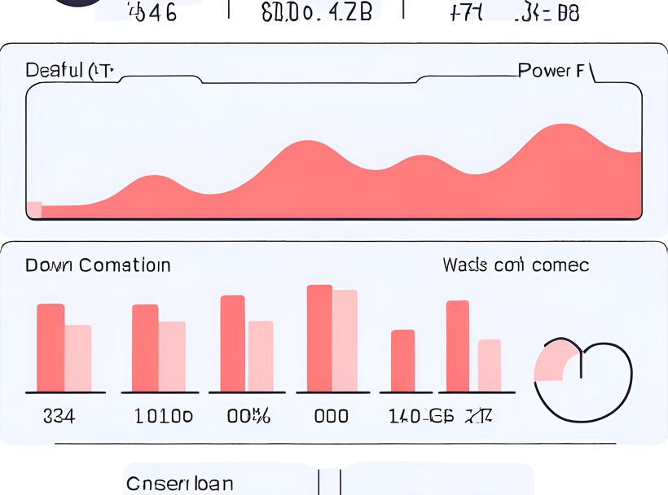
Steps Involved in the Project
1. Data Collection and Preprocessing: Collected raw preprocessed it using Python. Applied data cleaning ensure the data was ready for analysis.
data from the company's database and and feature engineering
techniques to
Exploratory Data Analysis (EDA): Conducted EDA on the preprocessed data using Python, including statistical analysis, visualizations, and identifying patterns and trends.
Export Data to Power BI: Exported the preprocessed data and EDA results to Power BI using a suitable file format like CSV.
Create the Dashboard: In Power BI, created a new report and added visualizations such as tables, charts, and graphs. Used Power BI's drag-and-drop interface to build a dashboard that effectively communicated the insights gained from the analysis.

Slide 4
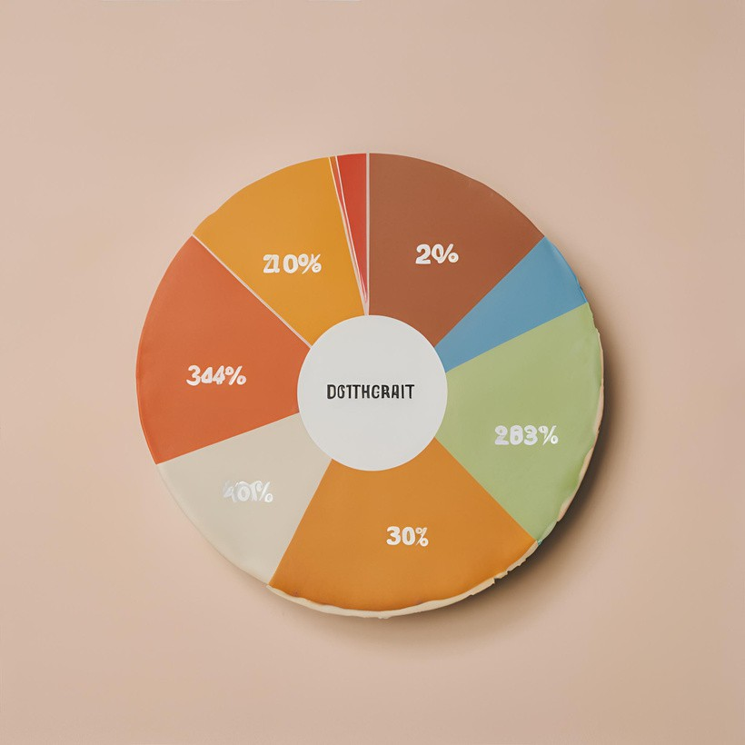
Benefits
User-Friendly Interface : Intuitive design and interactive features make it easy for users to explore and interpret energy consumption data.
Data Customization : Drop down slicers empower users to tailor the dashboard to their specific needs, focusing on relevant parameters.
Comprehensive Insights : The combination of diverse visualizations provides a comprehensive overview, allowing users to identify trends, patterns, and anomalies in energy consumption

Slide 5
Future Scope of Study
Smart Integration: Connect the dashboard with IoT devices, smart meters, and building
automation systems for real-time monitoring and control of energy usage, enhancing efficiency and responsiveness.
Predictive Analytics: Incorporate machine learning and predictive modeling to forecast
future energy consumption trends, anticipate potential issues, and proactively optimize energy usage.
Enhanced Visuals: Continuously improve visualizations and the user interface for better
usability, accessibility, and engagement. Utilize innovative visualization techniques and interactive features to provide deeper insights and facilitate decision-making.
Benchmarking: Implement benchmarking features to compare energy consumption
against industry standards, best practices, or peer organizations. This comparative analysis helps identify areas for improvement and drives continuous optimization efforts.
Custom Reporting: Enhance the dashboard's reporting capabilities to generate tailored
reports for specific stakeholders. Include automated report generation, ad-hoc reporting, and customizable dashboards for different user groups to meet diverse needs.

Slide 6
